Slide 1

Mini Project
Emotion Based Music Player
Team Members:
Prabhat Yadav(Team Lead)
Jayash Raj Singh Yadav
SUBMITTED TO: Mr. ROHIT RASTOGI
(Sr. Asst. Professor-CSE)
1

Slide 2

Contents:
Problem Introduction
1.1 Motivation
1.2 project objective
1.3 Scope of project
2. Libraries Used
3. Related Previous Work
4. Software and Hardware requirements
5. Proposed Method
6. Deliverables
7.Error Handling
8.Code snapshots
9. Stakeholders
10. Gantt Chart
11.Limitations and accuracy
12. References
2

Slide 3
Motivation:
“I have always loved to use smart devices, be it google assistance, Alexa, Cortana, or Siri, I was fascinated by the way how they reacted when we asked them something using only our voice and how beautifully the responded to that, in today's era of IoT and AI, one thing which I thought was lacking is they are unable to judge our mood or emotion and respond accordingly, I loved to listen to music but the traditional ways of choosing and making playlist are outdated, in today’s era when most of the things can be connected to an AI why can’t our music apps be like that, which can play according to our emotion and mood, therefore I thought of this project a long time ago but due to my own limitation of not knowing how to use ML or Python I could not complete the project than but when I got this opportunity I was excited to make that wish of communicating with the devices using our faces a reality.”
-Prabhat Yadav
3

Slide 4

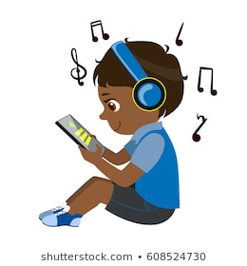

Project Objective:
This project makes the life of all music listeners easier and also aims to automate the process of music playing and makes the process a lot of fun. It plays the songs for the user that may fit their current emotion, helping the user automate the initial song selection.
4

Slide 5
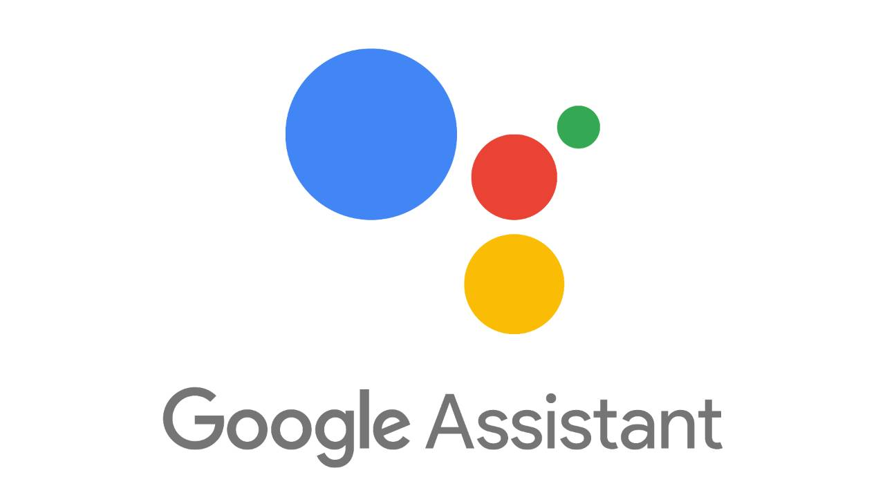

Scope of project
1.The application cannot be run on android or iOS, it can only be run on Windows, Linux, and macOS.In the future, this application may be available for android and iOS.
2.In future it can be integrated with different AI available to give better user experience.
3.Can be launched as a product.
5

Slide 6
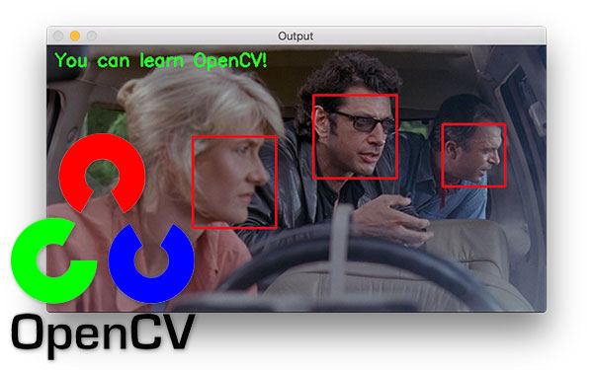
Libraries Used :
1.OpenCV- Image processing
2. Argparse -CLI(Command Line Interface)
3.Eel – connecting python and HTML,JS,CSS
4.Tkinter- graphical user interface(GUI) in python.
other python libraries used are - time, os, glob, random.
6

Slide 7




Related Previous Work
1. Spotify - this application gives the user accessibility features like playing songs from the top song list or already built playlist and recommending users based on their previous songs, which they have listened to, they also provide a feature like playing the songs in a loop or playing songs in queue.
2.Saavan -this application is also similar to Spotify and gives the user accessibility features like playing songs from the top song list or already built playlist and recommending users based on their previous songs, which they have listened to, they also provide a feature like playing the songs in a loop or playing songs in queue.
3.Youtube Music - All the above features which are provided by Saavan or Spotify are also provided by YouTube music apart from these features YouTube music comes with inbuilt support of google home(Which is google assistance) and can be controlled by using voice and it also makes playlist automatically for the user and recommends songs based on the previous choice of the user.
4.Amazon Music - Apart from all features mentioned above in various music applications. It comes with inbuilt support of Alexa which is amazon AI assistance and can be controlled by using voice and can be connected with Echo Dot which is an AI assistance device of Amazon.
7

Slide 8

Software and Hardware requirements
1. Hardware requirements
• Processor: 2 GHz
• RAM: 1 GB (2 GB recommended)
•Storage:200MB (500MB recommended)
•Webcam
2. Browser
• Chrome 51 or higher (latest recommended)
3.Database
• .csv file
4.Software requirements
•OS requirement :
•Windows 7 or higher
•Ubuntu 14 or above
•macOS 10.12 or above recommended
•Python2.8 or above(python 3 or above recommended)
8

Slide 9
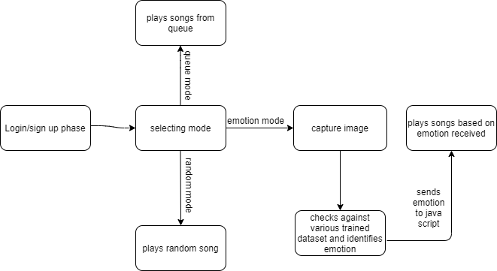
Proposed Method
The overall system can be divided into various logical stages like capturing an image, detection of a face, detection of landmark points on the detected face, classifying those feature points with the help of the OpenCV haarcascade_frontalface.xml, and then generating the playlist according to that recognized mood. During the training phase, a dataset of images will be created to train the model.xml while after implementation of the system a single captured image can be given to a trained model file to predict the mood. The different moods in which the system will classify the images are happy, neutral, and sad. The system will pre-sort the songs according to their genre in the above-mentioned categories.
9

Slide 10


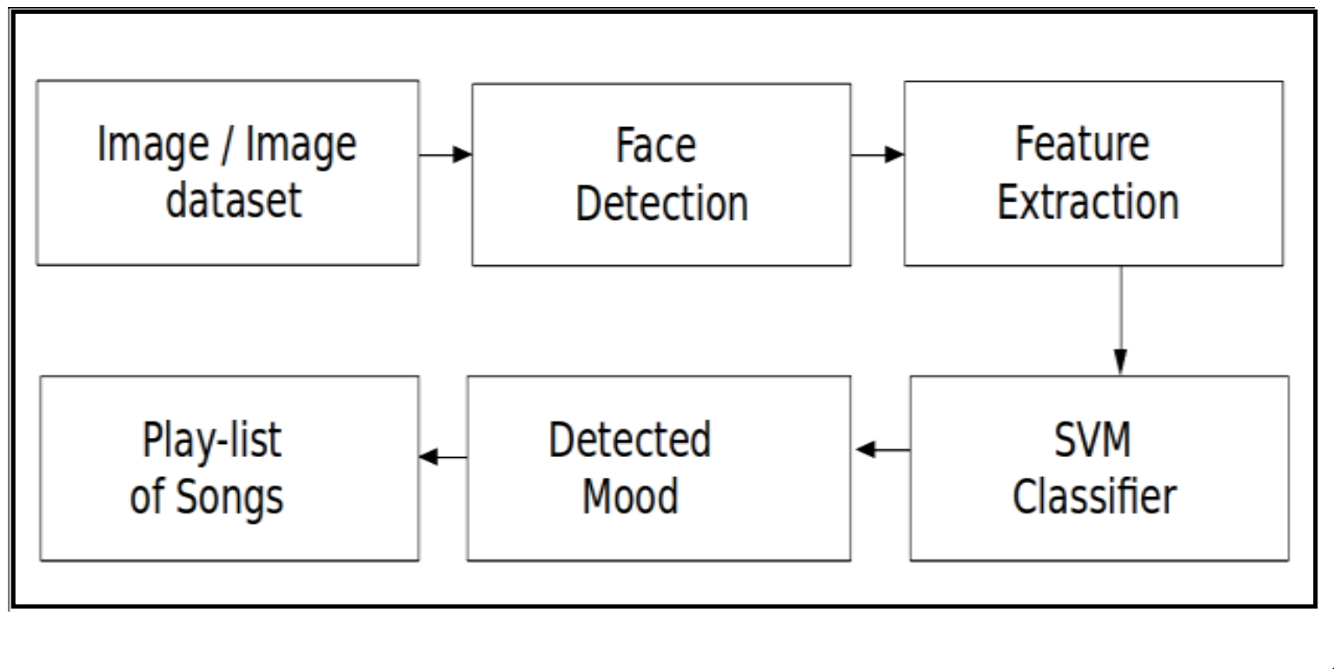
This image will be processed by the python code and converted into a 350x350 grayscale image for checking its emotion against the trained model.
This is Input Image which is captured by webcam.
This is output Image which will be evaluated for emotion.
10

Slide 11
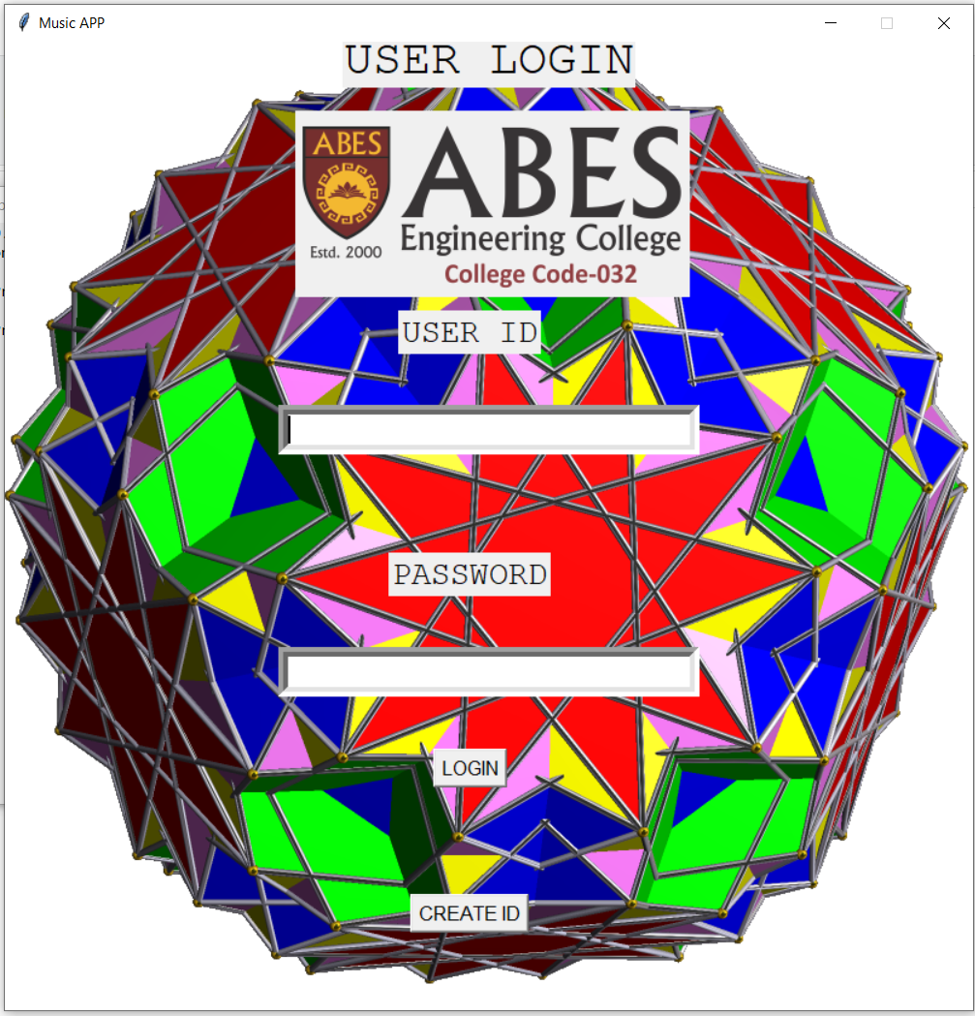
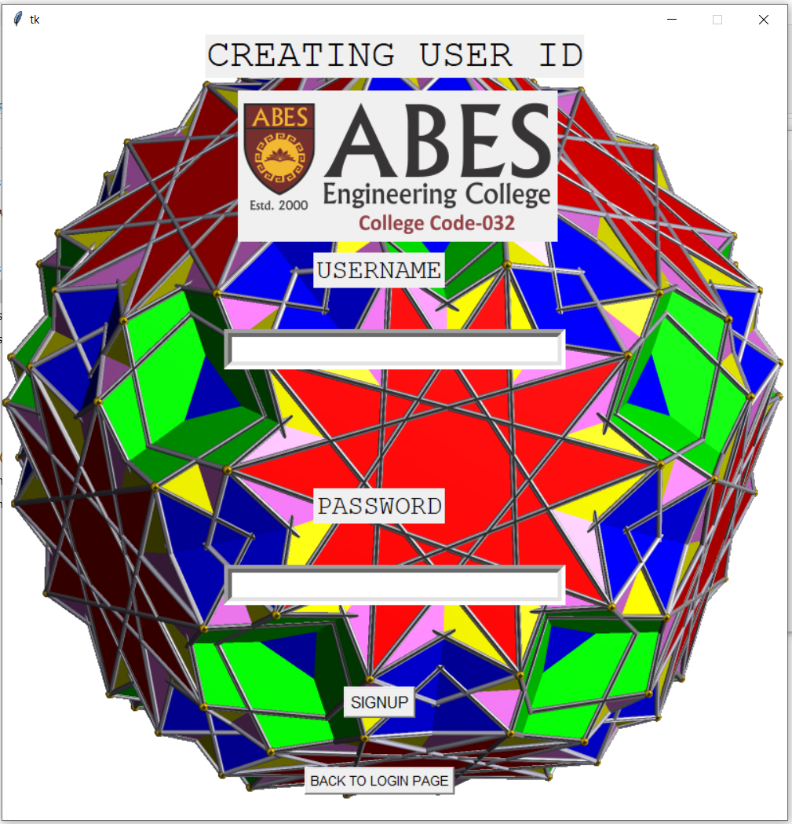
Deliverables
Login window
Signup window
11

Slide 12
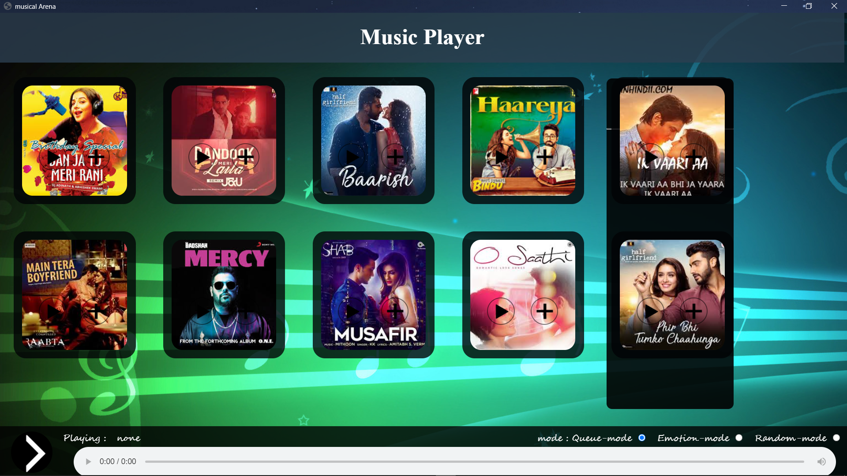
Mode selection
Main window
12

Slide 13
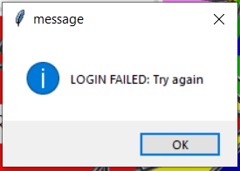
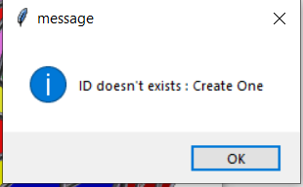
Error Handling
When wrong password entered by user
When wrong ID entered by user
13

Slide 14
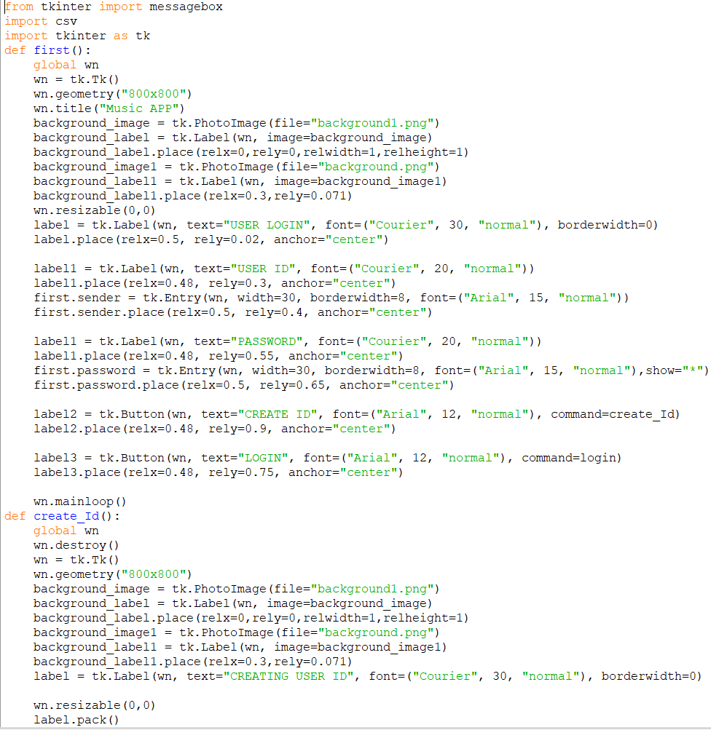
Code snapshots
Code for login and signup screen
14

Slide 15
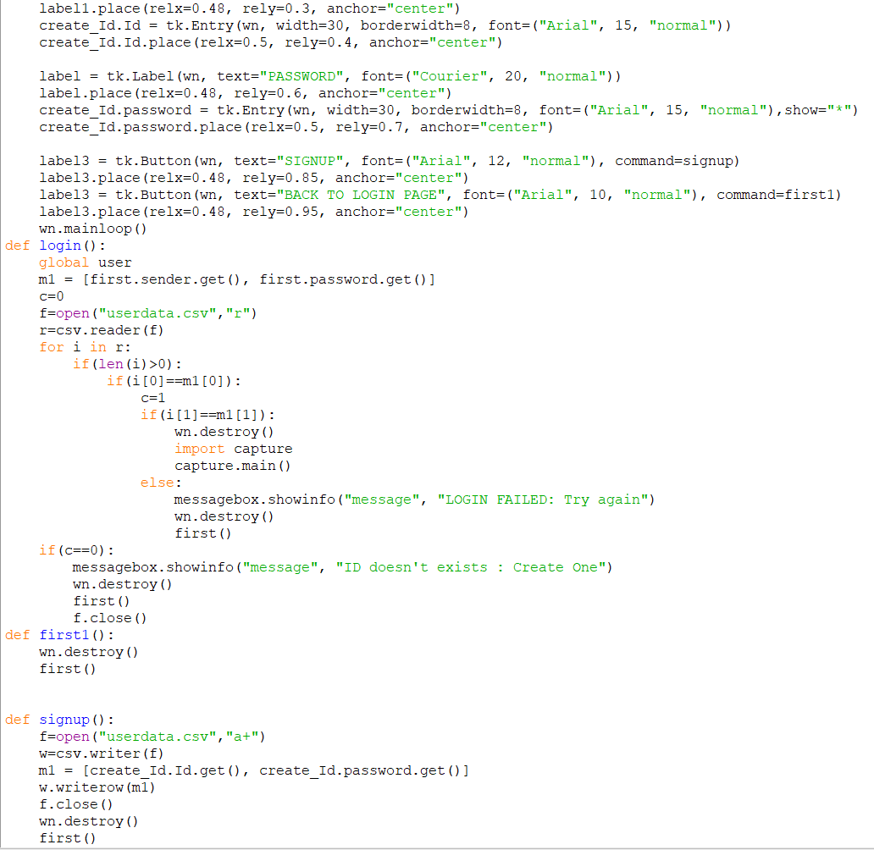
Code for login and signup screen
15

Slide 16
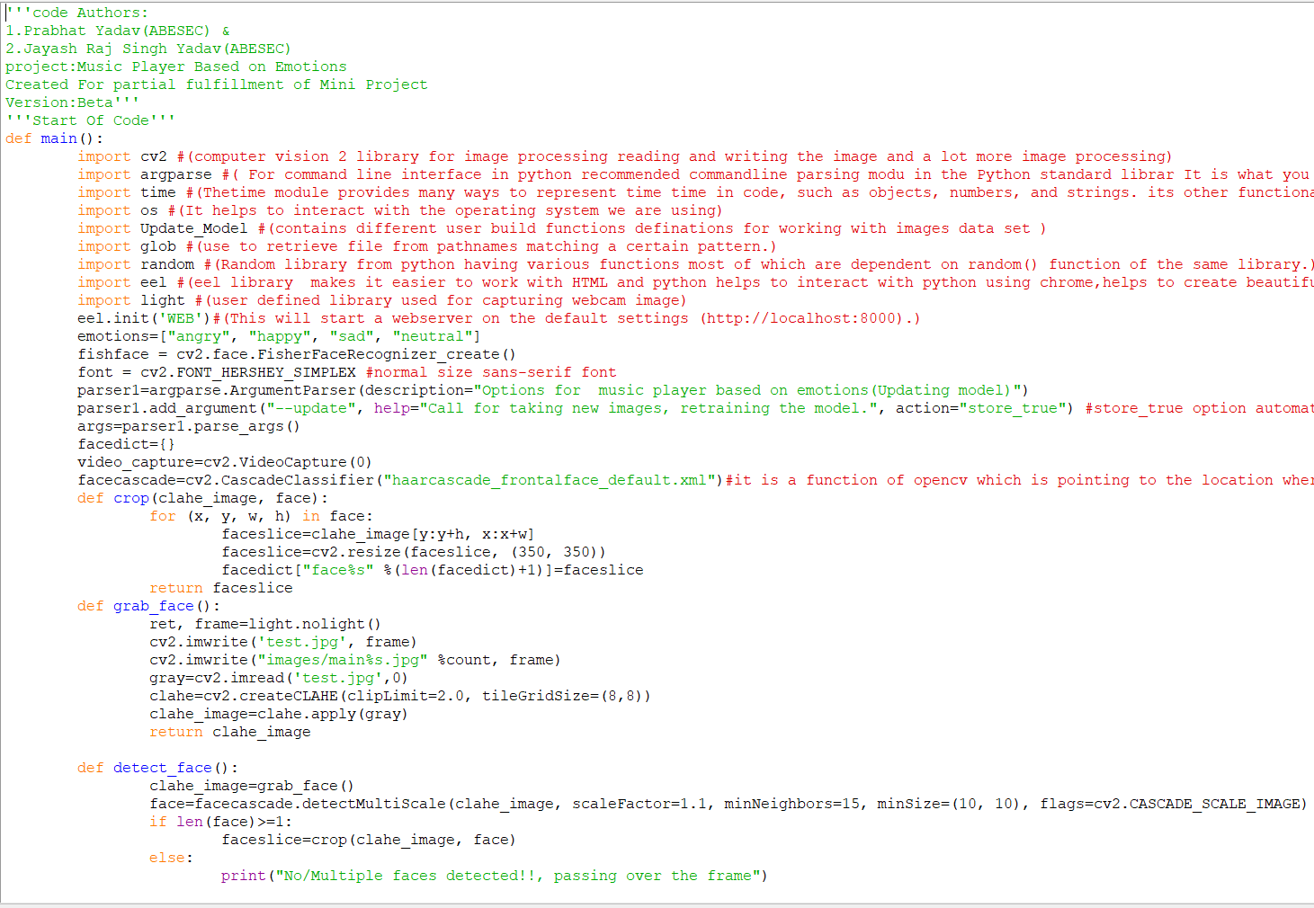
Code for Main screen
16

Slide 17
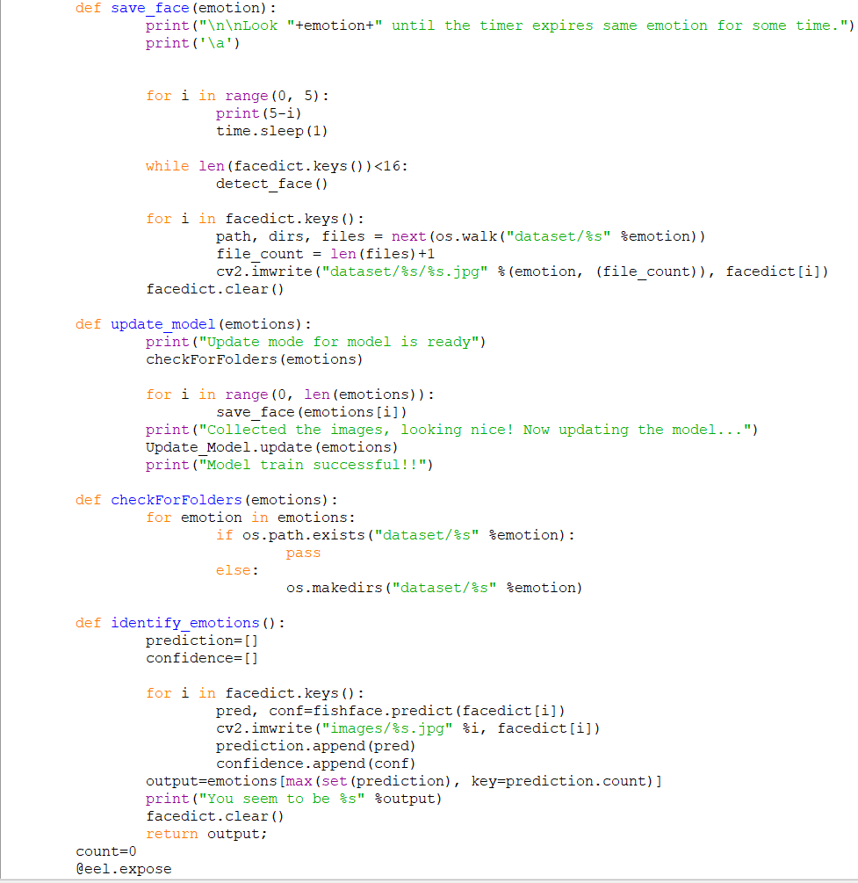
Code for Main screen
17

Slide 18
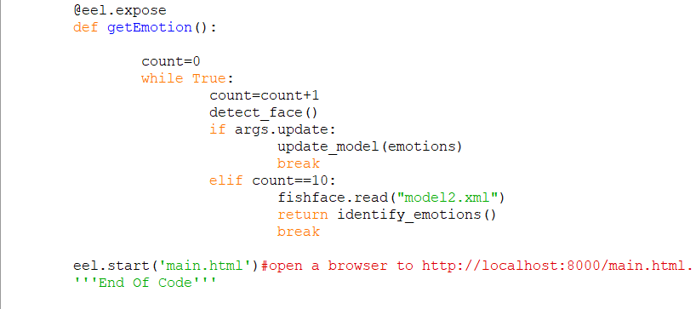
Code for Main screen
18

Slide 19
Stakeholders
1.Music Listeners: the music listeners will be benefitted most from this music application project, there lots of time and energy that will be saved which was previously wasted in selecting which song to play which will fit their mood. This application will automatically play the song based on the user emotion there saving users’ efforts to select songs. It will also be a fun way apart from the traditional way they used to create a playlist and play the song.
2.ML enthusiasts: ML learners will also be benefitted from this project. They can directly implement this application to various use and create other projects which use emotion recognition features. They can also directly use the functions created by code authors to train their own model for emotion recognition.
3.IT teams: IT teams that are looking for a unique music application system apart from traditional ones could find this music player handy and they could develop it further and it could be launched as a product.
4.Startups in Music Players: Startups that are looking to create some unique music players could integrate this application into their music players to boost the user’s experience and their sales could go up.
19

Slide 20
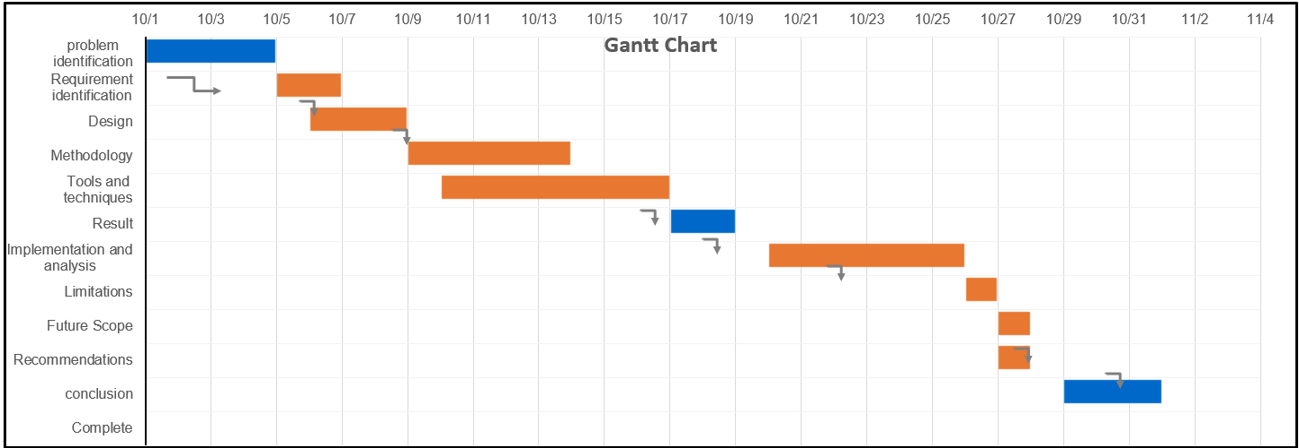
Gantt Chart
20

Slide 21
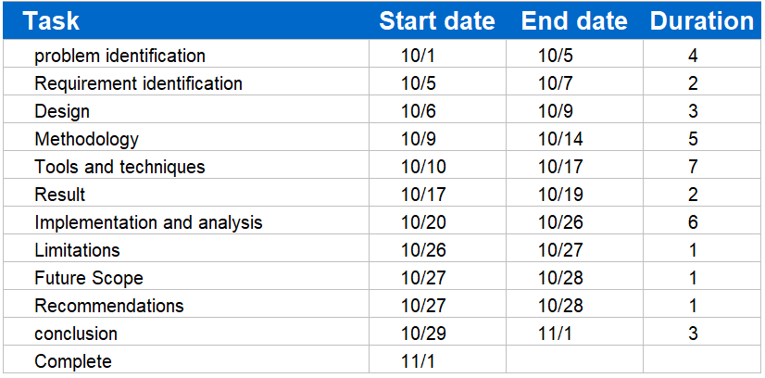
21

Slide 22
Limitations and accuracy
Limitations:
1)Adding and removing songs is a tedious job as someone with knowledge of JS, Html can only achieve it.
2)This expression detection is not accurate because of the small set of data used to train the model.
3)This can’t be run on android or iOS as for now.
Accuracy:
Due to smaller dataset of 414 images used the accuracy is lower closer to 70%.
Out of 107 trials performed 72 trials were correctly evaluated.
The accuracy could be increased by adding more images in dataset and retraining the model.
Poor lighting conditions, poor webcam quality are also reasons for lower accuracy.
22

Slide 23
References
1.Viola, P., Jones,(2001). M. Rapid object detection using a boosted cascade of simple features, Proceedings of the 2001 IEEE Computer Society Conference on, vol. 1, pp. 511-518 IEEE.
2.Abat, F., Maaoui, C., prusk, A.,(2011). Human-computer interaction using emotion recognition from facial expression, UK Sim 5th European Symposium on Computer Modeling and Simulation.
3.Davis E., (2009). A Machine Learning Toolkit, Journal of Machine Learning Research 10, pp. 1755- 1758.
4.https://docs.opencv.org/master/d7/da8/tutorial_table_of_content_imgproc.html
5.https://www.sciencedirect.com/topics/computer-science/emotion-recognition
6.https://www.frontiersin.org/articles/10.3389/fpsyg.2018.01303/full
23

Slide 24


Slide 25


